Slide 1
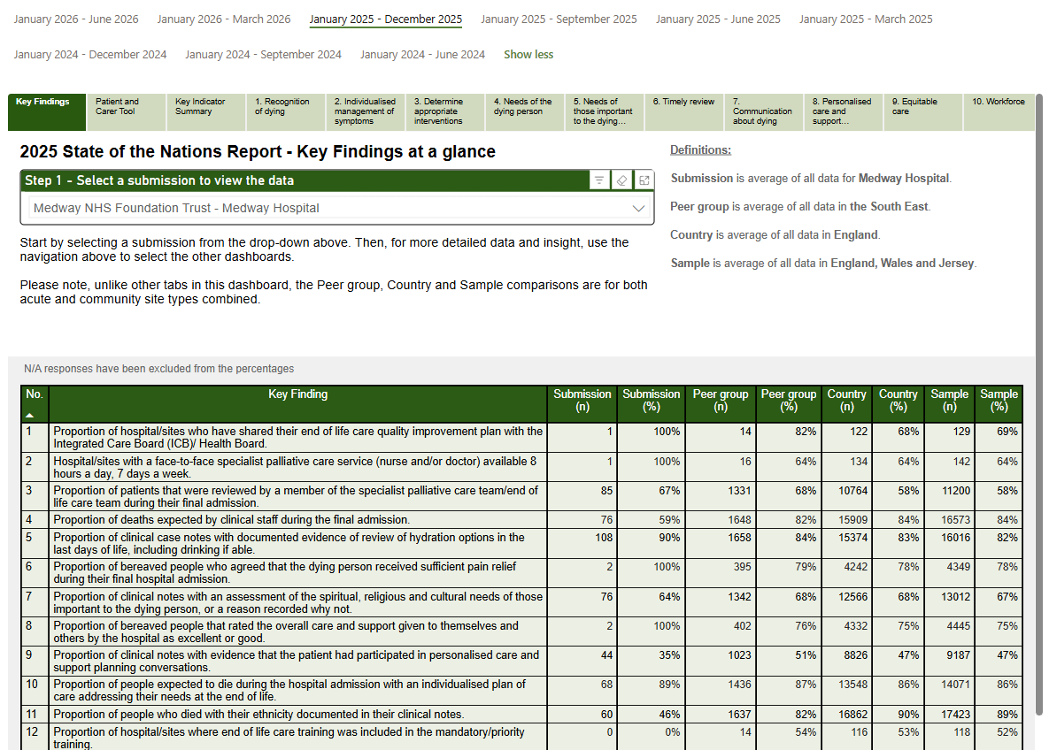
Instructions to create your bespoke infographic
There are two methods to find your organisations data:
Method 1
Use the PowerBI dashboard available on the NACEL Data and Improvement Tool.
  Login to the NACEL DIT
  Go to “Dashboards”
  Select “January 2025 – December 2025”
  Go to the Dashboard ‘Key Findings’
  Find your organisation’s submission(s) in the dropdown
  Follow instructions on slide 3 to copy your findings into the infographic template on slide 4
Example submission
Example submission

Slide 2

Instructions to create your bespoke infographic
There are two methods to find your organisations data:
Method 2
Use your bespoke dashboard report available on the NACEL Data and Improvement Tool
  Login to the NACEL DIT
  Go to “Documents”
  Use the “Report Name Index” to identify the report tag used for your report
  Use the search function to find your report
  Follow instructions on slide 3 to copy your findings into the infographic template on slide 4

Slide 3
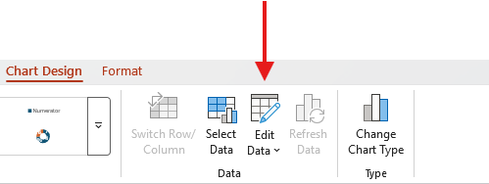
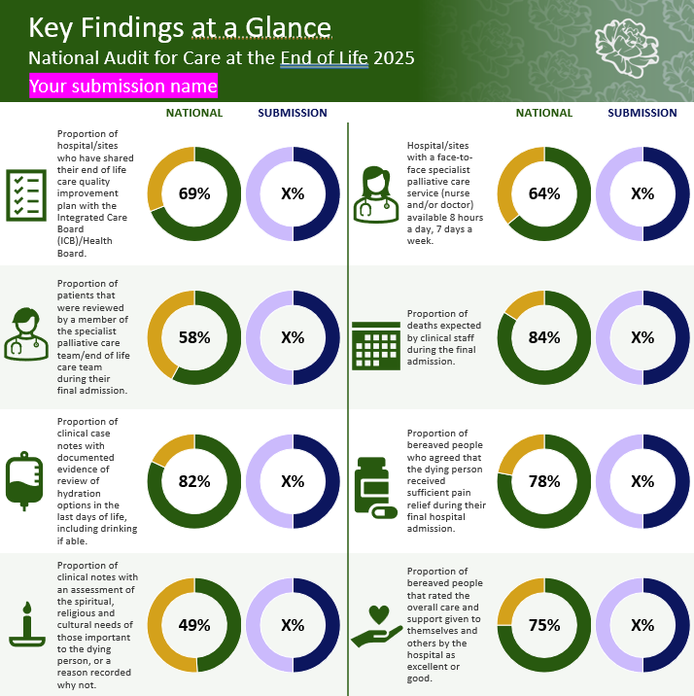
Instructions to create your bespoke infographic
Populate the template
  Insert name of the Trust and the submission
  Populate the “Submission” pie charts by clicking the pie chart and then selecting the option ‘Edit Data’ from the ‘Chart Design’ tab.
  This will open up an Excel data table to populate your submission results.
    Ensure you input both the numerator (your percentage finding) and the non-numerator (100 – your percentage finding = non-numerator). You may be asked to insert your percentages as decimals.
    Example: If your finding is 75% then your non-numerator would be 25%. You would input 0.75 as the numerator and 0.25 as the non-numerator. Double check the chart looks the way it should.
  Manually type your findings result in place of the ‘X’ value for each pie chart.

Slide 4


Key Findings at a Glance
National Audit for Care at the End of Life 2025
Your submission name
NATIONAL
SUBMISSION
NATIONAL
SUBMISSION
Proportion of hospital/sites who have shared their end of life care quality improvement plan with the Integrated Care Board (ICB)/Health Board.
69%
X%
Hospital/sites with a face-to-face specialist palliative care service (nurse and/or doctor) available 8 hours a day, 7 days a week.
64%
X%
Proportion of patients that were reviewed by a member of the specialist palliative care team/end of life care team during their final admission.
58%
X%
Proportion of deaths expected by clinical staff during the final admission.
84%
X%
Proportion of clinical case notes with documented evidence of review of hydration options in the last days of life, including drinking if able.
82%
X%
Proportion of bereaved people who agreed that the dying person received sufficient pain relief during their final hospital admission.
78%
X%
Proportion of clinical notes with an assessment of the spiritual, religious and cultural needs of those important to the dying person, or a reason recorded why not.
49%
X%
Proportion of bereaved people that rated the overall care and support given to themselves and others by the hospital as excellent or good.
75%
X%
Proportion of clinical notes with evidence that the patient had participated in personalised care and support planning conversations.
47%
X%
Proportion of people expected to die during the hospital admission with an individualised plan of care addressing their needs at the end of life.
86%
X%
Proportion of people who died with their ethnicity documented in their clinical notes.
89%
X%
Proportion of hospital/sites where end of life care training was included in the mandatory/ priority training.
52%
X%
‘National’ refers to the results for acute and community hospitals in England, Wales and Jersey.

